Slide 1
Emotional Community Detection in Social Network
By
Aasthaba Zala
School of Computer Science
University of Windsor
COMP-8920-3: Social Network Data Analysis
Dr. Pooya Moradian Zadeh

Slide 2
INTRODUCTION
Emotions are very interested topic and it is described as intense feelings that are directed at something or someone in response to internal or external events having a particular significance for the individual. And in today’s time Internet has become a key medium through which people express their point of view, feelings and emotions. Every event, news or activity around the globe, is shared, discussed, posted and commented on social networks, by millions of people. Capturing the emotions of people in text, especially those posted on social media, can be a source of precious information, which can be used to study how different people react to different situations.

Slide 3
Business companies can use this information to track feelings and opinions of people to find out what people think about various products. The problem with most of the Sentiment Analysis that is done today is that the analysis only informs whether the public reaction is positive, neutral or negative but unable to describe the exact feelings of the customers. With my emotional analysis, they can have a more profound analysis of their markets than the previous Sentiment Analysis, which itself has turned their businesses more profitable.
Also, health-analysts can study the thinking of individuals or groups at different times of the day or in response to certain situations. It can also be used to formulate the mental or emotional state of an individual, studying their activity over a specific period of time, and possibly detect depression risks.

Slide 4
RELATED WORK
In the recent past, with the rise of social media, interest rate has been increased for Sentiment Analysis. Lately, a lot of research has been done on classifying comments, opinions, reviews, recommendations and other forms of online expressions into positive, neutral and negative sentiments.
Wiebe et al. worked on the manual annotation of emotions, opinions and sentiments in a sentence corpus of news articles.
Segundo et al. also studies the presence of emotions in text, and is a functional theory of the language used for expressing attitudes, judgments and emotions.
one research work classified text into six Emotion Categories, but that was only limited to classification of news headlines.

Slide 5
My concept
I proposed a new idea to classify and quantify tweets according to standard emotions suggested by Paul Ekman. Here, I did my analysis on tweets posted on Twitter, but it can be easily extended to any kind of text whether it is one lined headlines, messages and posts on social networks.
I have developed a system that could score any piece of text, especially tweets and posts on social media according to different Emotion-Categories: Happy, Sad, Fearful, Surprise, Angry, Loved, Anxious and many more.
Another significant contribution is that I have devised a system that could find an efficient data set for analysis. Moreover, I created a system which can collect a data set by live streaming also.

Slide 6
Requirements
Windows
Python Platform (Pycharm)
Packages
Twitter API

Slide 7
architecture
Data sets
Tokenizing and Annotating
EWS
Finding matching keywords with EWS
Words are successfully categorized in the appropriate category

Slide 8
Data sets
Tweets Set
I used Tweepy library to collect tweets, which is a Python library for accessing the Twitter API. It takes as input various parameters, such as coordinates, radius, etc., and after removal of duplicates, links, hashtags, and words in other languages (besides English) from these tweets, stores the tweet-ids, text and location of the most recent ones in the database. This provided me with a list of tweets from various locations across the country.
Live tweets set
I created another data set which is created doing live streaming. In this, we are able to get tweet of random people from any area. And after that it will stored into text file and further processed.

Slide 9
Emotion words sets
A selection of relevant and commonly-used Emotion words is one of the most essential and indispensable aspects in the emotional quantification of a whole sentence. I have created a high-quality accurate bag of words, called Emotion-Words Set. It has been developed by manually which are the synonyms of the basic Emotion-Categories (HAPPY, SAD, ANGRY, SURPRISE, FEARFUL, FEARLESS, LOVE, ANXIOUS AND MANY MORE).
Word | Category
amused | happy
disheartened | sad
bewildered | surprise
cautious | fearful
bitter | angry
distrustful | anxious
TABLE I: An example of EWS

Slide 10
Overview of the method
Using NLP and EWS:
The first approach uses the tweets in Tweets Set, which are already free from any unwanted characters, hyperlinks or hashtags. The following steps comprise the first approach. 1) Tokenizing and Annotating: First, I tokenize the tweets into sentences, which are further tokenized into tokens. Then, I remove all the stop words from these tokens.
Finding Hits:
In this step, the annotated tokens are matched against the words present in the EWS.A matched token along with all its characteristics/annotations is stored as a hit.
Then I stop the words which are not useful for the detection.

Slide 11
System design
Input(Search Datasets):
Data in the form of raw tweets is acquired by using the Python library “tweepy” which provides a package for simple twitter streaming API . This API allows two modes of accessing tweets: it simply delivers a small, random sample of all the tweets streaming at a real time
Tweets Retrieval:
Since human labelling is an expensive process. I further filter out the tweets to be labelled so that we have the greatest amount of variation in tweets without the loss of generality. It filters useless words.
Search Datasets
Tweets Retrieval
Tweets
Processed
Sentiment Analysis
Tweets Categorized

Slide 12
System design
Classified Tweets:
I labelled the tweets in three classes according to sentiments observed in the tweets: positive, negative and neutral.
Positive: If the entire tweet has a positive/happy attitude or if something is mentioned with positive connotations. Also if more than one sentiment is expressed in the tweet but the positive sentiment is more dominant.
Negative: If the entire tweet has a negative/sad attitude or if something is mentioned with negative connotations. Also if more than one sentiment is expressed in the tweet but the negative sentiment is more dominant.
Neutral: If the creator of tweet expresses no personal opinion in the tweet and merely transmits information. Advertisements of different products would be labelled under this category.

Slide 13
Experimental setup
First of all, I created twitter Developer account. And after that I got its API. Then I Chose PYCHARM as a platform, because it was feasible for me. Then imported few packages which were crucial for my analysis.
I imported the following packages:
1)tweepy
2) matplot
3)textblob
4)Pandas
5)numpy
6)re
7)string.

Slide 14
How I got twitter api
To get a Twitter API, I created developer’s account on twitter.
And after that I got four key which I used as a twitter credentials.
I put all keys in one python file and it is used for sentimental analysis. Without that we cannot able to get the tweets of people.
I used it to my both kind of search.

Slide 15
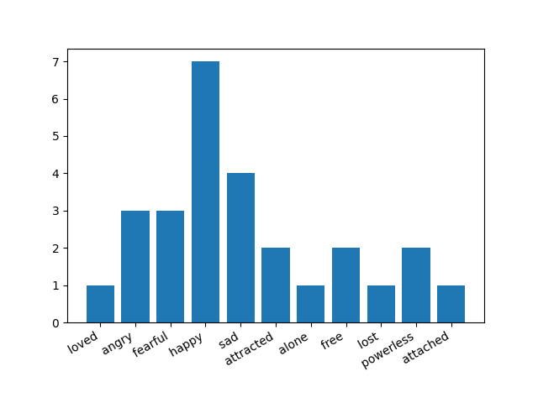
Experimental setup

Slide 16
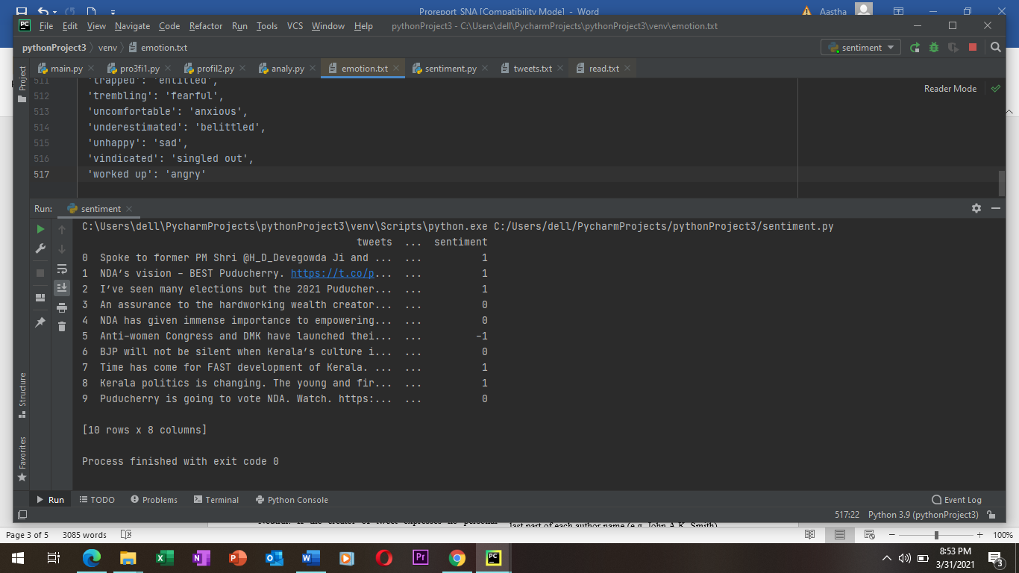
Experimental setup

Slide 17
conclusion
In this paper, I have addressed the problem of classifying text into the basic Emotion-Categories, rather than just labelling them as positive or negative. Through my research reliable bag of emotional words, I can now effectively quantify many emotions in any block of text.
In future, a system could be established for automatically updating the bag-of-words and automatically generate matching word sets . Using this approach, many interesting apps can be created, such as a social-networking site displaying the recent mood of your friends. Moreover, my analysis of Twitter can be extended to the development of a real-time application, analyzing mood-swings and emotions on Twitter.

Slide 18
references
Rakesh C Balabantaray, Mudasir Mohammad, and Nibha Sharma. Multiclass twitter emotion classification: A new approach. International Journal of Applied Information Systems, 4(1):48–53, 2012.
Cecilia Ovesdotter Alm, Dan Roth, and Richard Sproat. Emotions from text: machine learning for text-based emotion prediction. In Proceedings of the conference on human language technology and empirical methods in natural language processing, pages 579–586. Association for Computational Linguistics, 2005.
Janyce Wiebe, Theresa Wilson, and Claire Cardie. Annotating expressions of opinions and emotions in language. Language resources and evaluation, 39(2-3):165–210, 2005.
Paulo Roberto Gonc¸alves Segundo. The language of evaluation: Appraisal in english (martin, jr & white, rrr). Linha D’Agua ´ , (21):133–137, 2008.
Carlo Strapparava and Rada Mihalcea. Learning to identify emotions in text. In Proceedings of the 2008 ACM symposium on Applied computing, pages 1556–1560. ACM, 2008.

Slide 19
Thank you

Slide 20
Any questions?

